Slide 1
Raster to Vector conversions in the Case of Uncertainty
Cristobal Guerrero
James Schaffer
Department of Electrical and Computer Engineering, Summer 2012

Slide 2
Recap
- A resizing function was implemented for decreasing computational time.
- Testing of a few samples took place for finding the discrete error in the rasterred region and the vectorized region.

Slide 3
Genetic Algorithm
- A Genetic Algorithm is a search heuristic that mimics natural evolution.
- We want a genetic algorithm to learn what the parameters of the uncertain region should be.
- This will be done by implementing a fitness function to yield better results.

Slide 4
Fitness Function
- Is used to summarise how close a given design solution is to achieving the set aims.
-Using a fitness function will take more computational time.
- Once the models parameters are determined after 'n' cases the models generic parameters can be used.

Slide 5
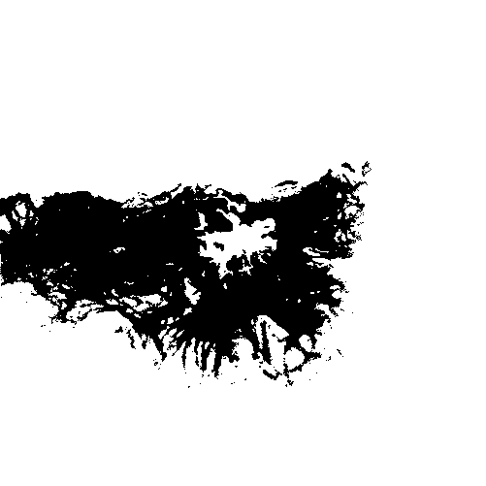
Probability
f( x,y in core ) = 1
0 < f( x,y in support ) < 1
f( x,y outside object ) = 0

Slide 6
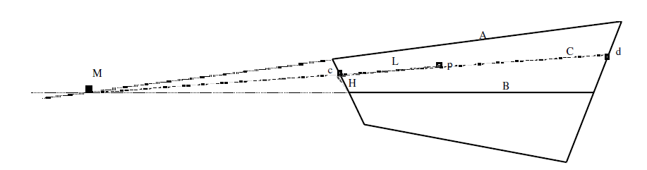
Calculating Probability
-The example above is for calculating the probability when the core of the supported region is not at its center.
-A simple straightforward method of of calculating the probability is as follows:
P(p) = F(ds/ds+dc)
ds - distance to support
dc - distance to core

Slide 7
Calculating Error (Discrete)
-The error calculation checks to see if the probability from the raster is the same as the probability calculated of the vectorized region.
-This is done by encompassing all the points of the raster in a polygon and then checking the probability value at the same point in the vectorized region.

Slide 8
Future Iteration
-Fix and work with the original model from Tossebro and have a simple working version of it.
-Add a genetic algorithm in order for machine learning.
-Adjust my probability function in order for it to work with the original implementation from Tossebro.

